Slide 1
Zillow Apartment Pricing 3.22.2023
Tony Fernandez

Slide 2
AGENDA
Introduction
Primary goal
How did we get the data?
Summary Statistics
Linear Regression

Slide 3
INTRODUCTION
​Rental apartment data was pulled from Zillow in OC CA
Data was pulled on 3.22.2023
Linear regression was used to estimate Renal Price explained by Square Feet.

Slide 4
PRIMARY GOAL
To understand apartment data in OC and build a linear regression model to model price of rent per month.

Slide 5



How did we get the data?
Chrome extension to
scrape Zillow.com
Python for combining files,
Pandas profile,
and sending data to excel file
Excel for summarizing data
and linear regression model

Slide 6
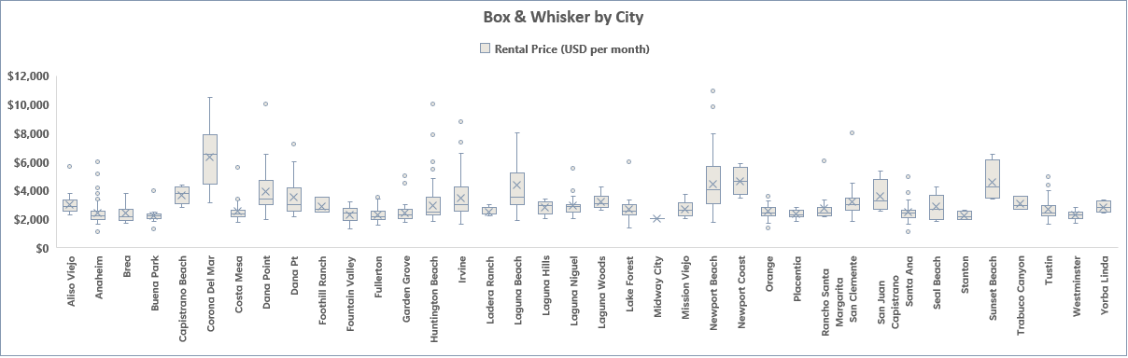
Summary statistics

Slide 7
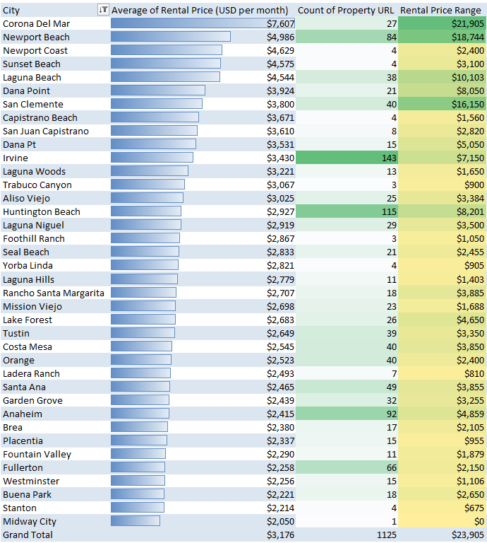
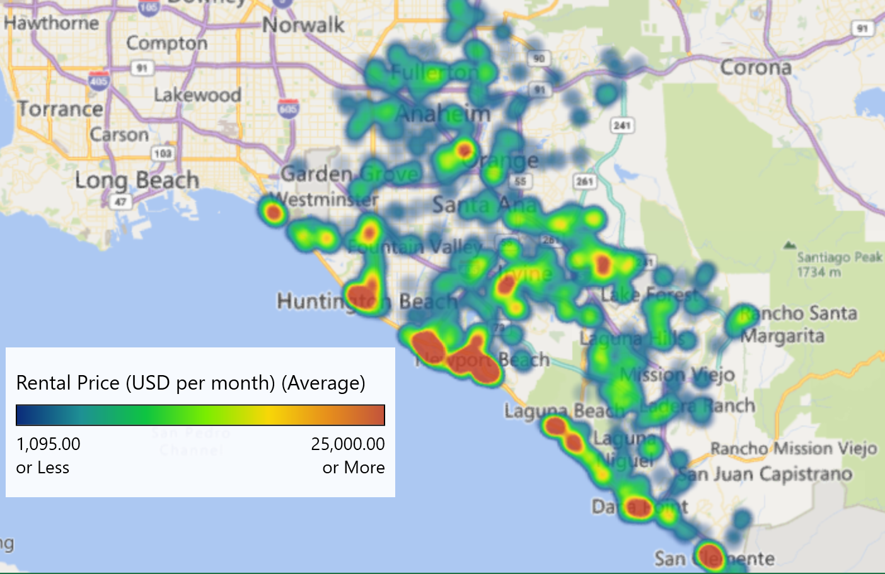
Summary statistics
Rental Price (USD per month)
Mean | $3174
Standard Error | 55
Median | 2620
Mode | 3500
Standard Deviation | 1832
Sample Variance | 3357798
Kurtosis | 36.18
Skewness | 4.78
Range | 23905
Minimum | 1095
Maximum | 25000
Sum | 3579863
Count | 1128

Slide 8
Linear Regression
Square Feet | Price/Month
1000 sf | $ 3,463.91
1200 sf | $ 4,083.33
1400 sf | $ 4,702.75
1600 sf | $ 5,322.17

Slide 9
Thank you
Tony Fernandez
tony.f.fernandez@gmail.com
949.973.1060

